Slide 1
Tricarboxylic Acid Cycle

Slide 2
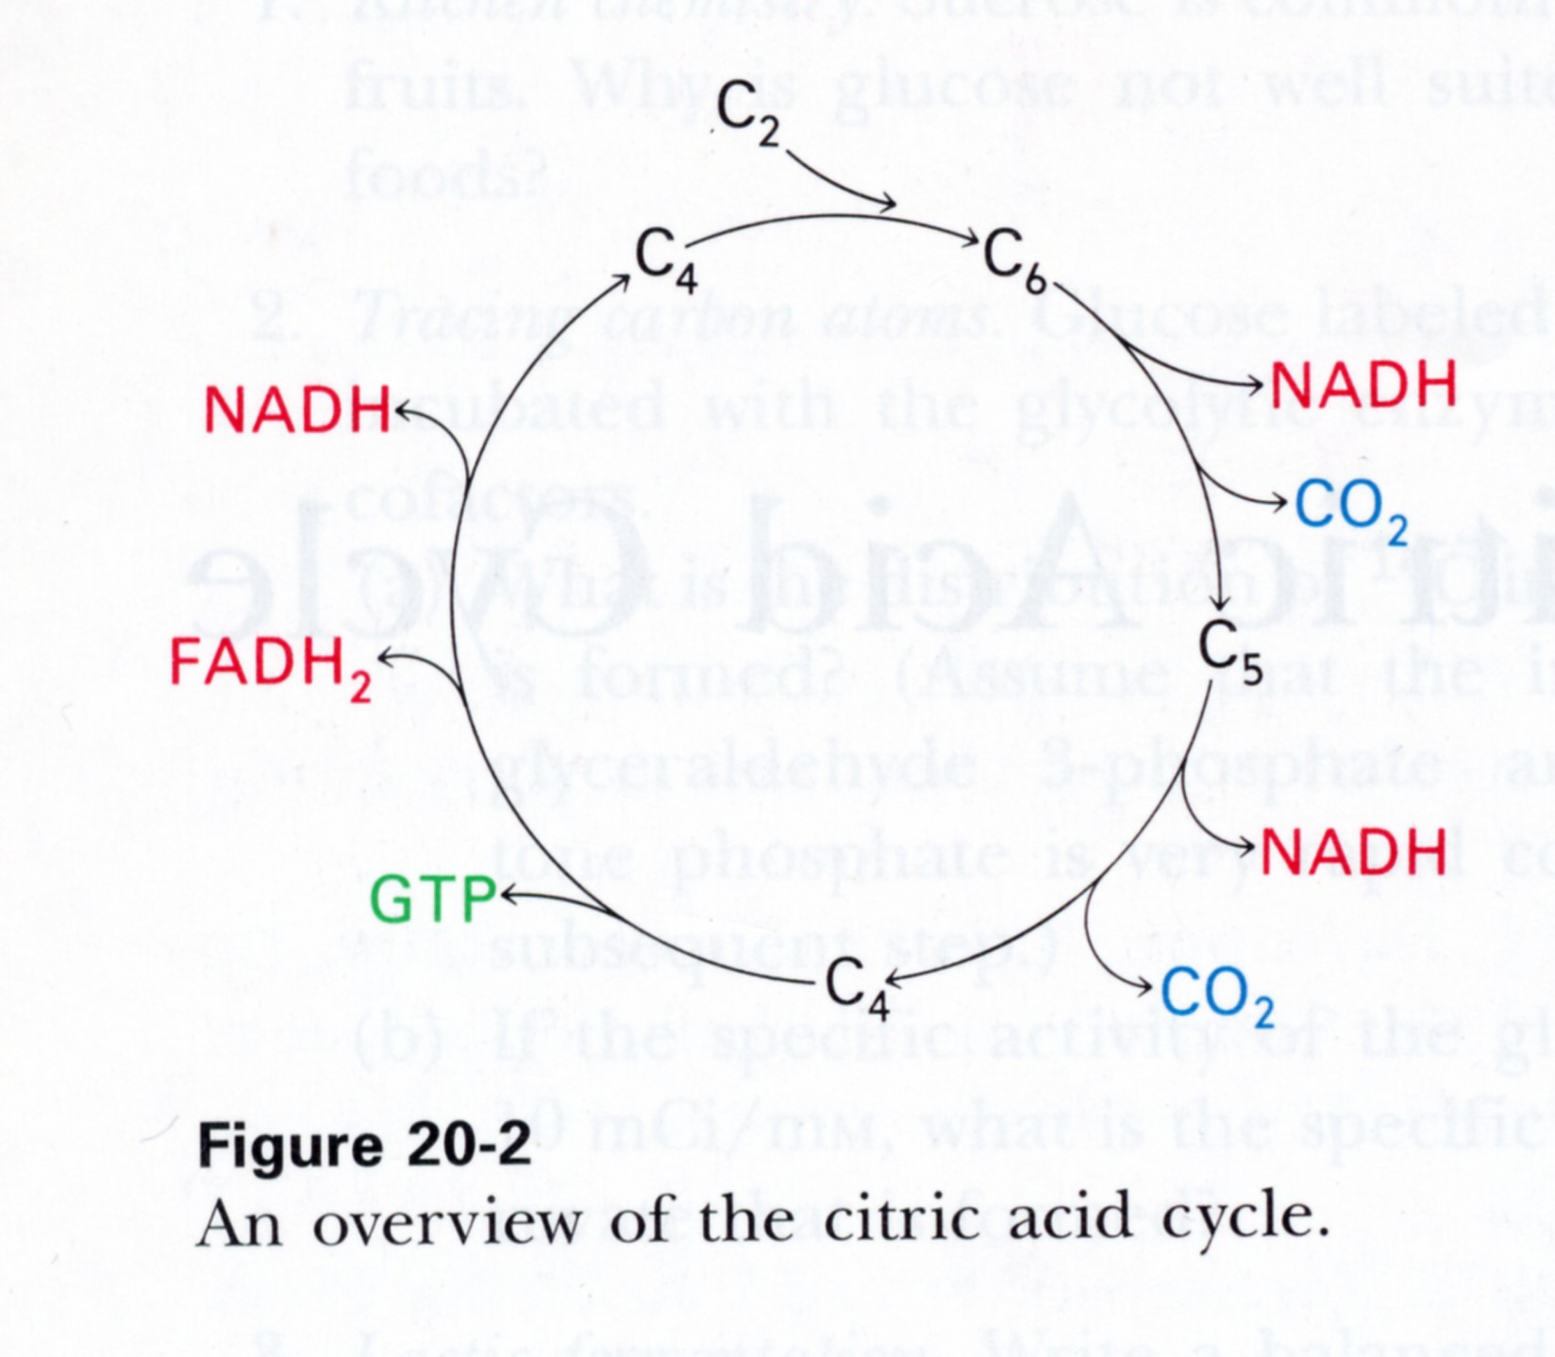
Purpose of the Citric Acid Cycle
Acetyl - CoA
A) Complete Oxidation of Acetyl C’s (& H’s)
ATP

Slide 3
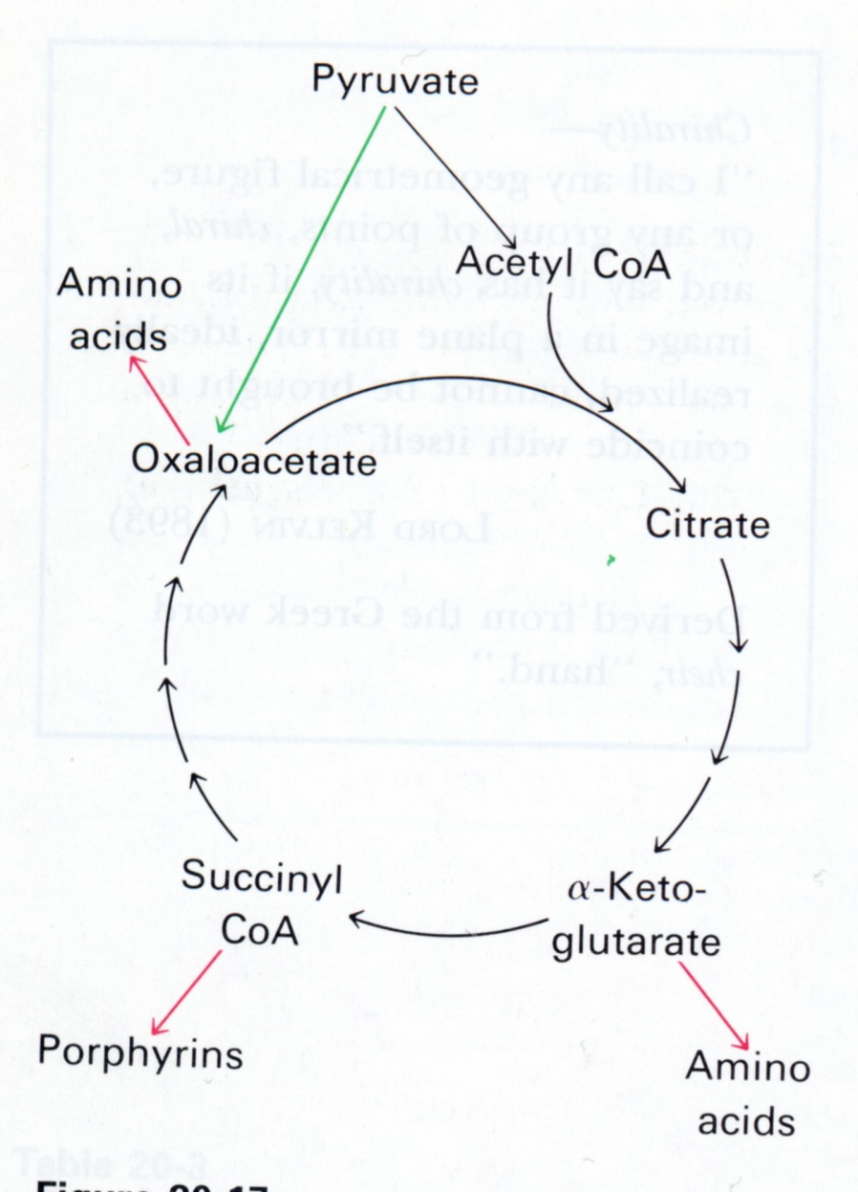
FFA’s
B) Generation of precursors for synthesis of macro-molecules
ATP

Slide 4
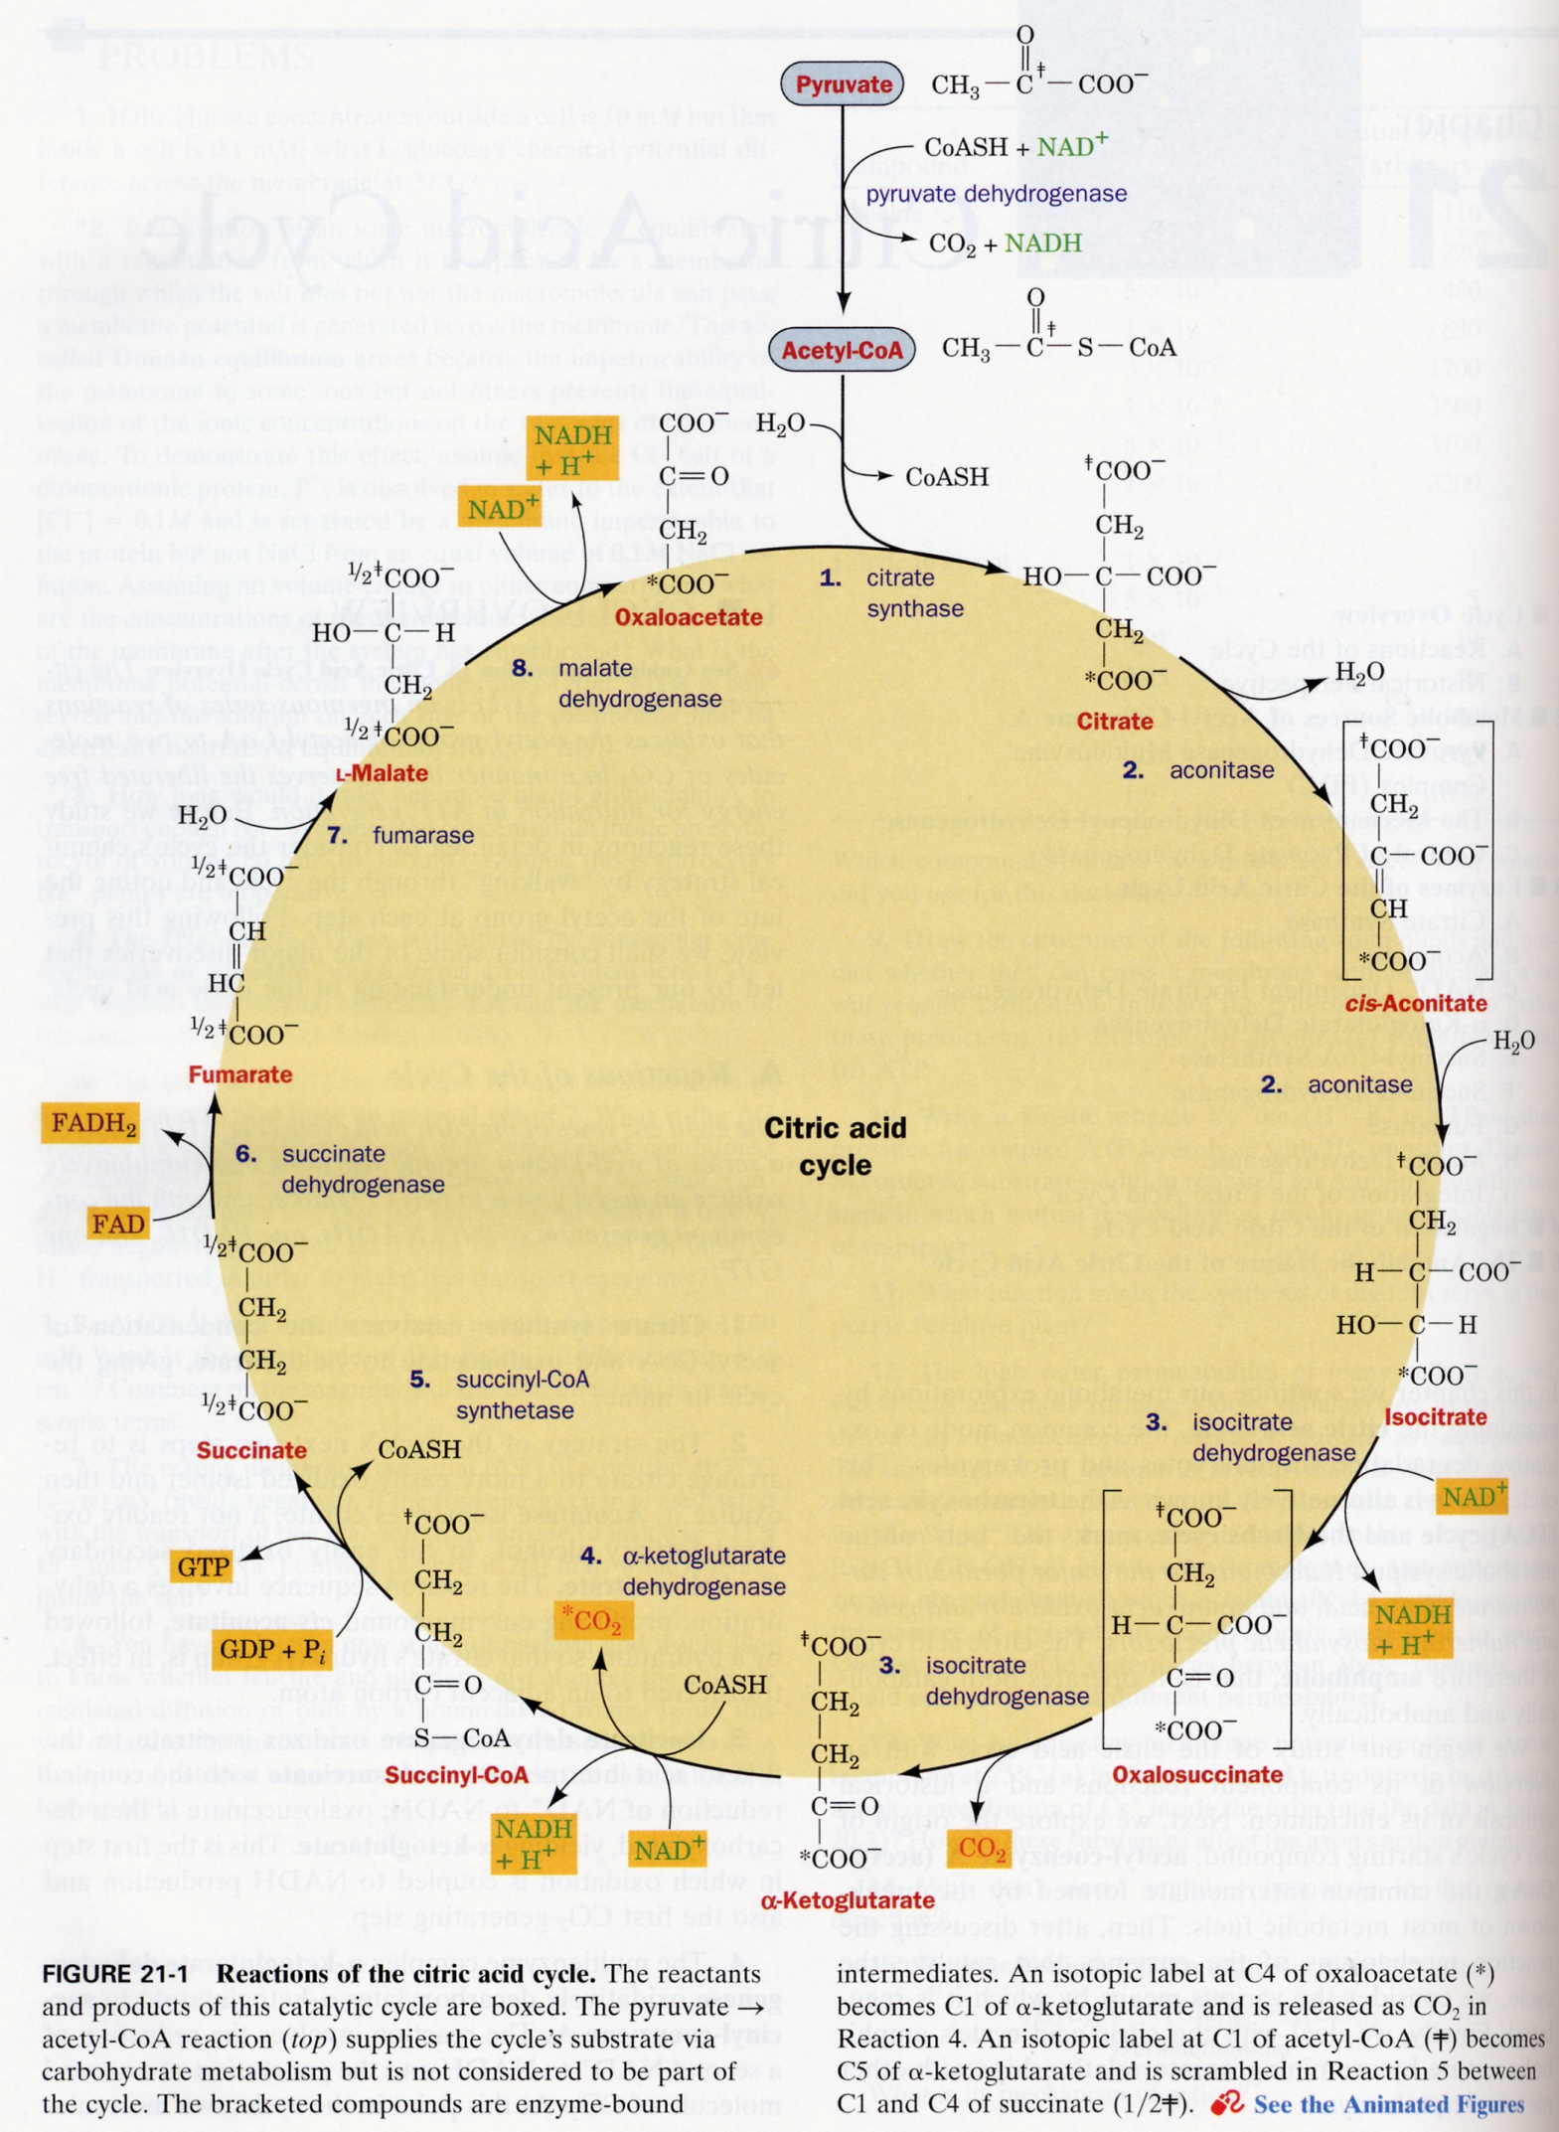
•
•

Slide 5
1
COO⁻
6
CH₂
HC—COO⁻
5
1
2
C=O
1
COO⁻
oxalsuccinate

Slide 6
Major Steps:
Formation of oxalosuccinate from oxaloacetate and acetyl-CoA
Decarboxylation
Regeneration of oxaloacetate

Slide 7
•
•

Slide 8
2 C’s are liberated from TCA cycle. Two enter via acetyl-CoA.
8 e’s are liberated. Eight enter via acetyl-CoA.
For Homework:
4 O’s are liberated. Where do they enter?
8 H⁺’s are liberated. Where do they enter?

Slide 9
Logic of TCA cycle
CoA
CO₂
C=O
1
COO⁻
CO₂
CH₃
6
CH₂
acetyl-CoA
+
HC—COO⁻
5
1
H₂C—COO⁻
H₂C—COO⁻
2
C=O
C=O
C=O
1
COO⁻
COO⁻
oxalsuccinate
COO⁻
oxaloacetate
oxaloacetate

Slide 10
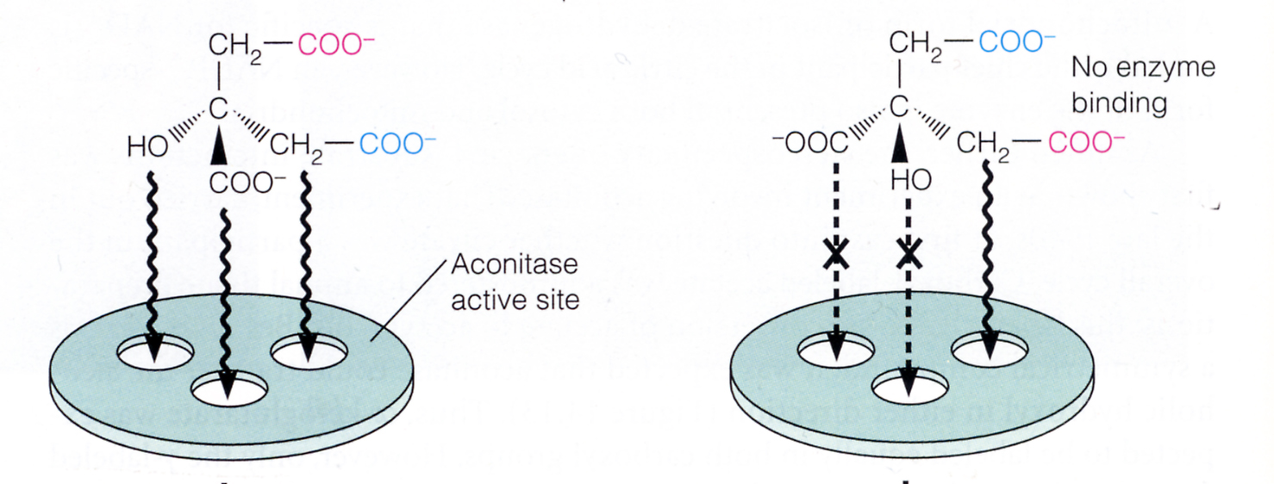
Citrate is prochiral
HO
CH₂
HO
CH₂
COO⁻
COO⁻
Matthews 3rd ed. p500

Slide 11
Evidence for the TCA cycle

Slide 12
Carbon can be labeled with C¹⁴ radioisotope
•
•

Slide 13
[Hot]
Specific Radioactivity =
[Hot + Cold]
Hot = labeled
Cold = unlabeled

Slide 14
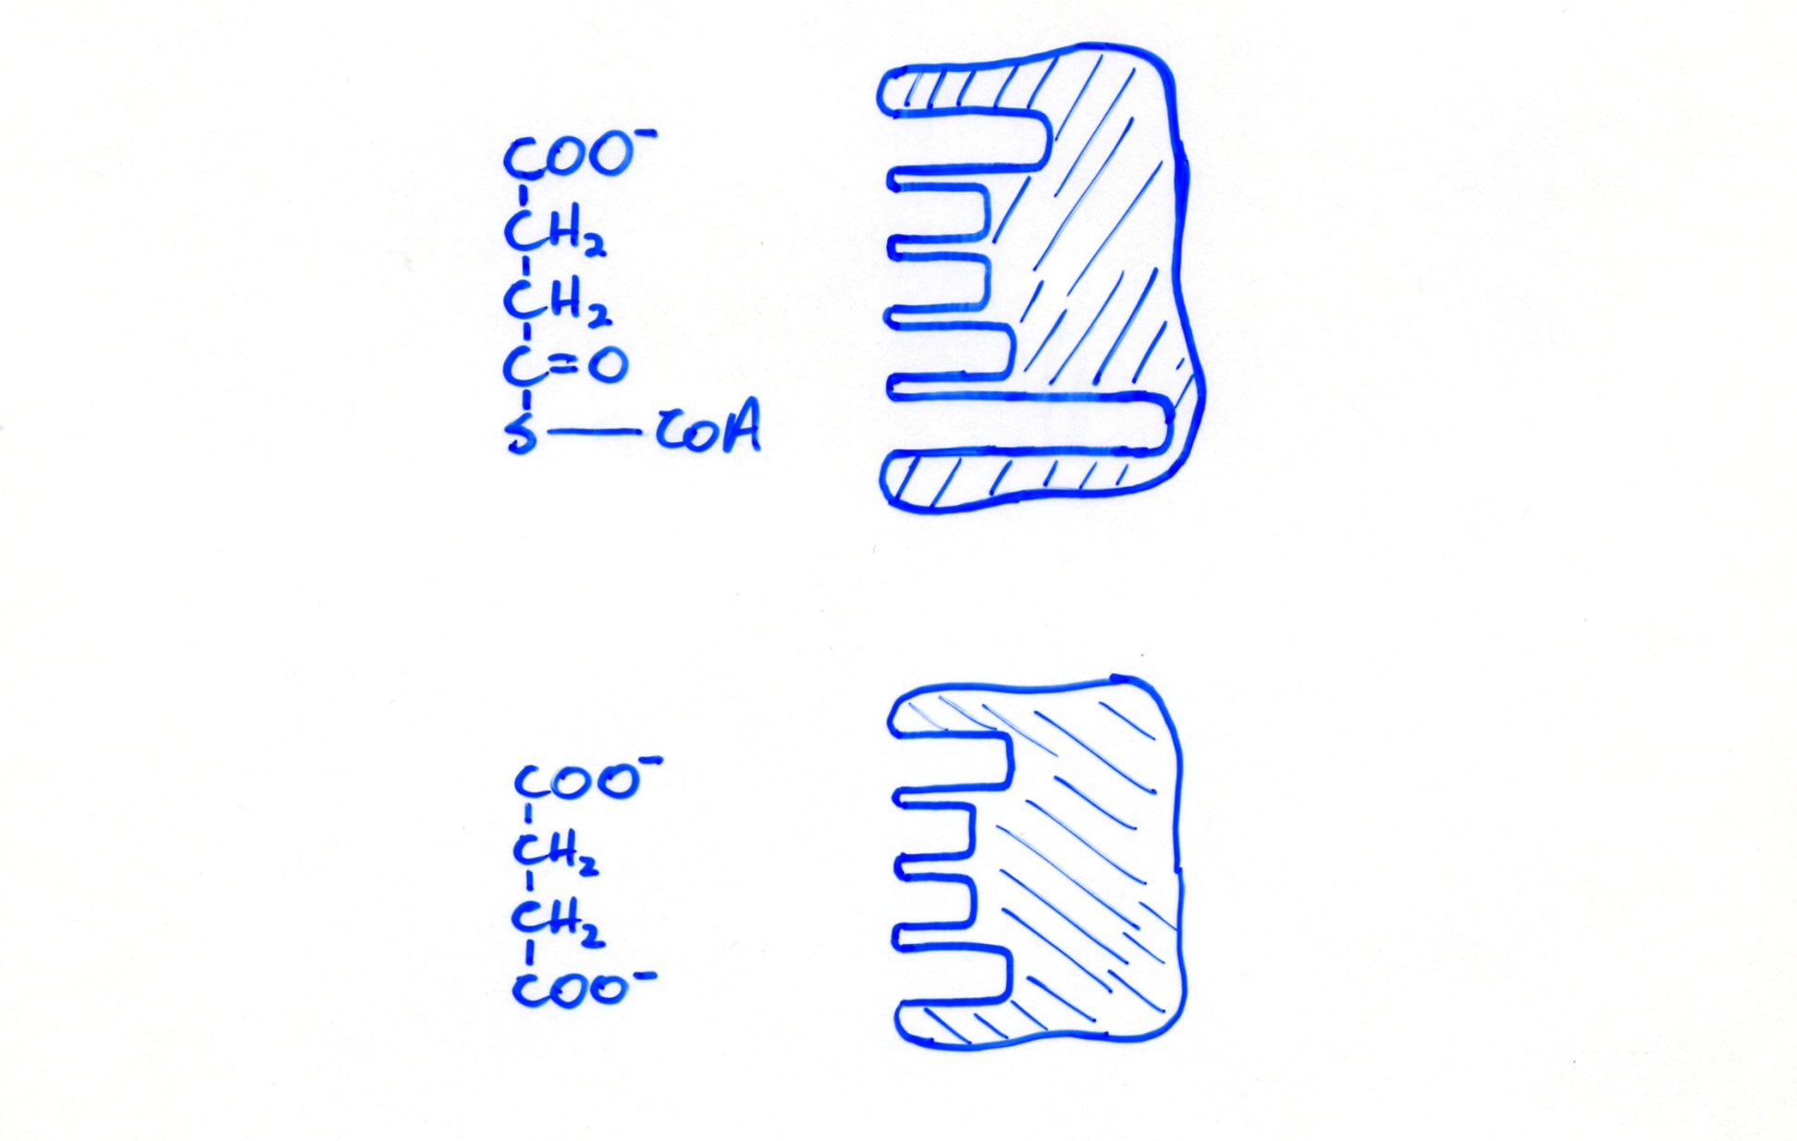
Radiolabel remains 100% on C1
*
Succinyl-CoA Synthetase
Succinyl-CoA
*
Succinate dehydrogenase
Succinate

Slide 15
However, C1 cannot be distinguished from C4 in succinate.
*
*
*
*
*
*
*
*
*
*

Slide 16
Thus, radioisotope is scrambled at succinate. It appears to be 50% C1, 50% C4.
*
Succinyl-CoA Synthetase
Succinyl-CoA
1/2
*
Succinate dehydrogenase
Succinate
*
1/2

Slide 17
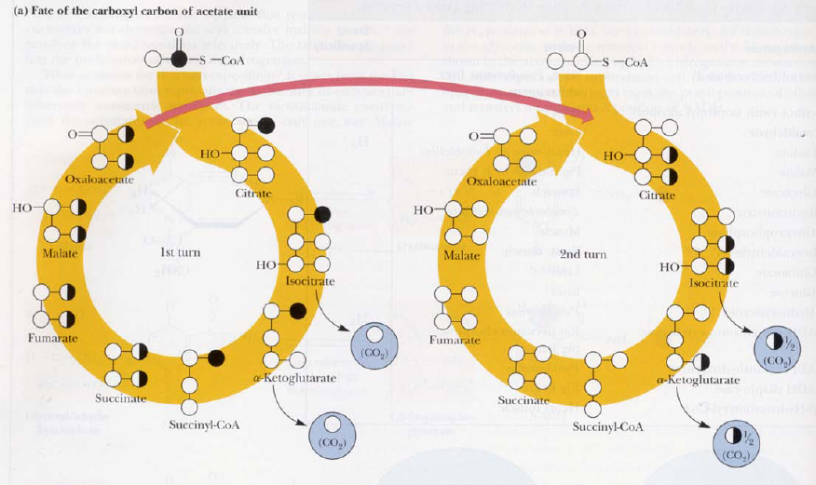

Slide 18
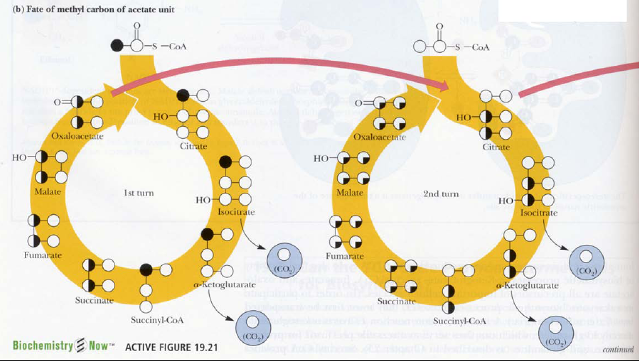

Slide 20
Stoichiometry of the TCA Cycle
For every one turn of the cycle:
1.
O
4 e- pair process
H
C
S
2
C
O₂
3
+6H
2. 3 NAD⁺ 3NADH + 3H⁺
1 FAD 1FADH₂
3. 2O₂ 4H₂O
4. 1 GTP produced.
GTP + ADP GDP + ATP ∆G°=0
+2H
+8H

Slide 21
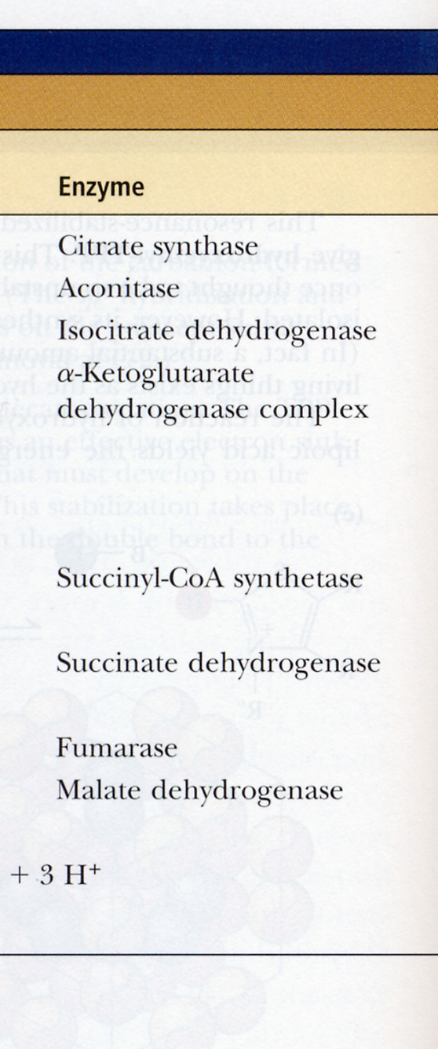
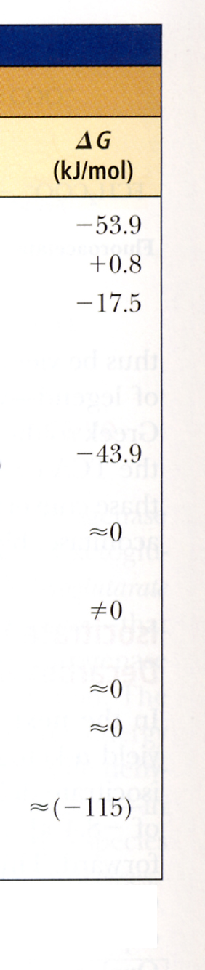
4.2 kJ = 1 kcal

Slide 22
Control of Citrate Synthase, Isocitrate DH, α-Ketoglutarate DH
Large degree of control is achieved by substrate availability and product inhibition.
Acetyl CoA & Oxaloacetate and NADH are critical.
Both Acetyl CoA & Oxaloacetate are subsaturating
Therefore : [substrate] → activity of citrate synthase.
Relative
Velocity
Physiological range
Substrate

Slide 23
[Acetyl-CoA] is regulated by PDH activity
[Oxaloacetate] is regulated by intracellular redox potential: [NADH]/[NAD⁺]
Malate + NAD⁺ Oxaloacetate + NADH + H⁺ ∆G~0
For example:
Exercise → NADH/NAD⁺ ratio
NADH, NAD⁺ → Oxaloacetate → Citrate Synthesis

Slide 24

−
↑NADH
−
−

Slide 25
Product Inhibition vs. Reaction Reversal
Two conditions for reaction reversal:
Both products must be present
Must be thermodynamically possible
13

Slide 26
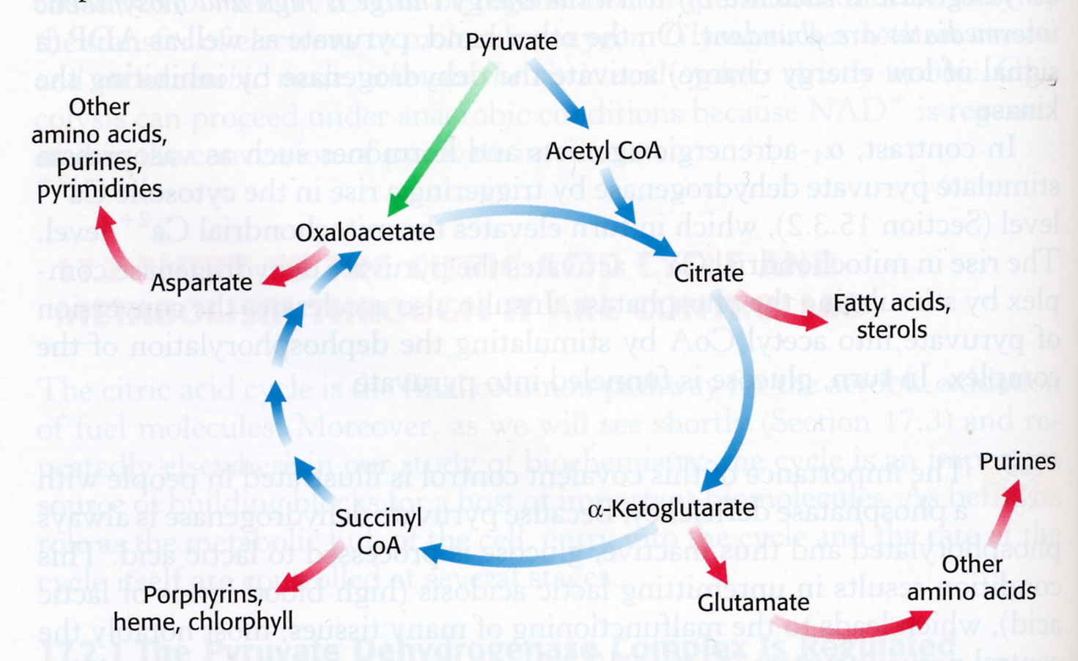
Anaplerotic Reactions
10
FFAs
Pyruvate Carboxylase
10
4
10
2
2
6
8
2
2

Slide 27
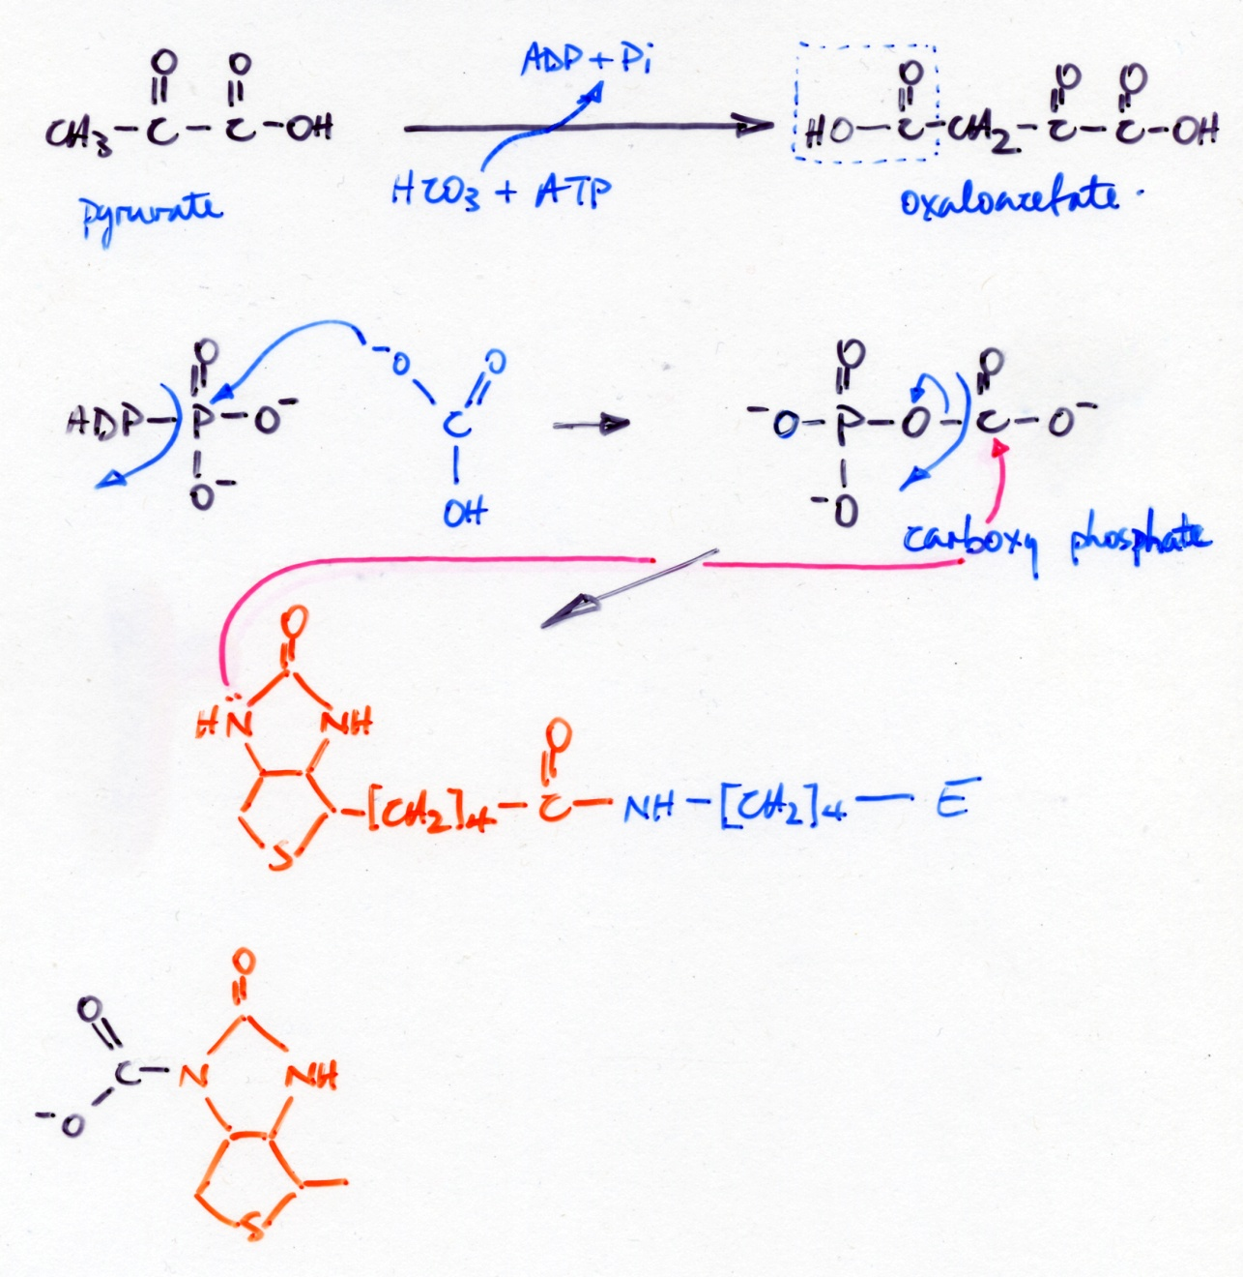
Mechanism of Pyruvate Carboxylase

Slide 28
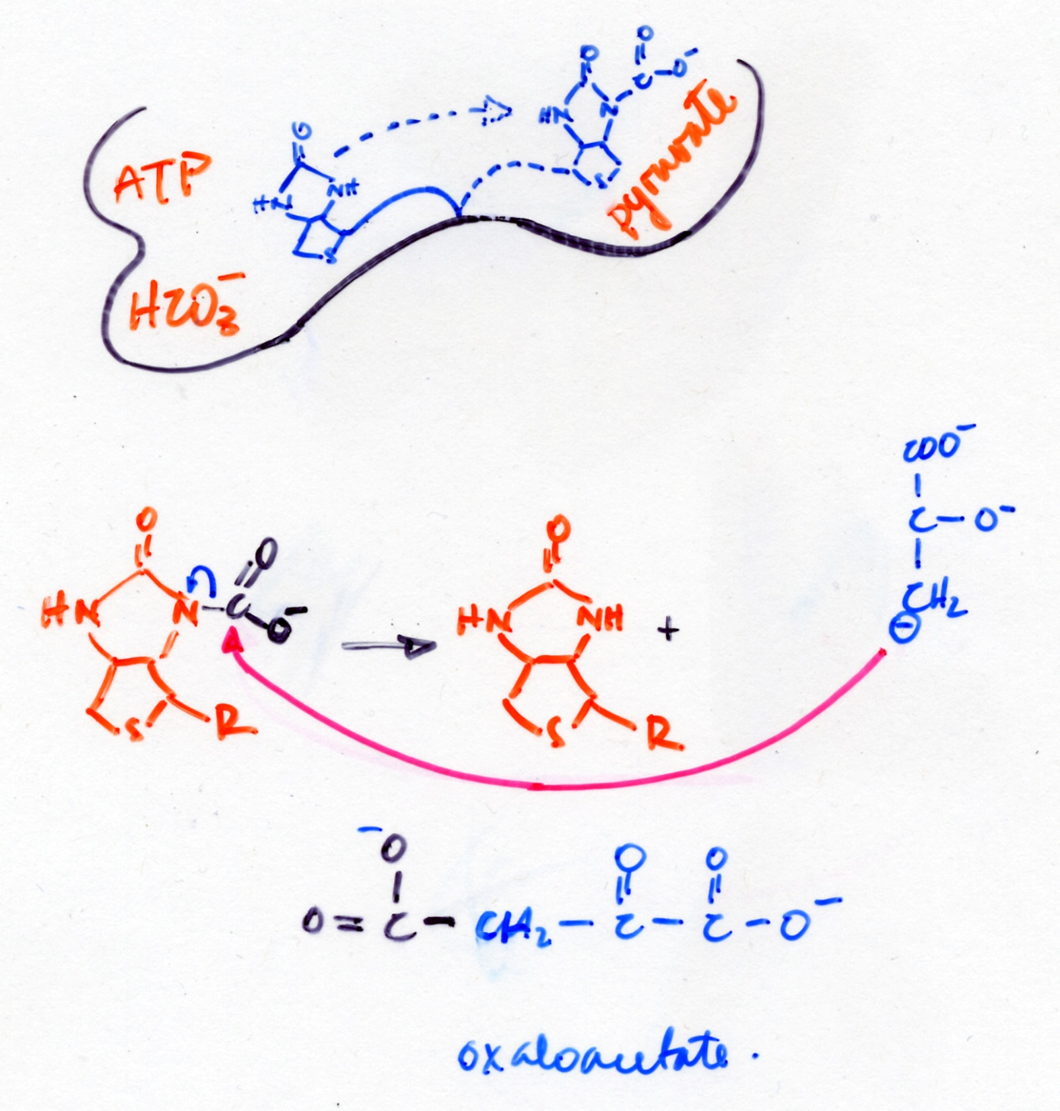

Slide 29
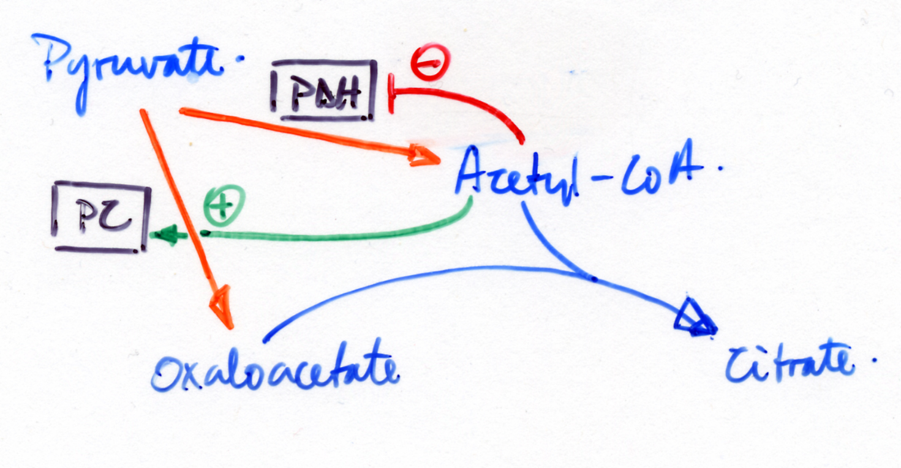
Coordinate Regulation of Pyruvate Metabolism
FFAs

